Slide 1


Oracle database
Lecture 47

Slide 2

Today’s Agenda
Introduction To Trigger
Uses Of Trigger
Types Of Triggers
Trigger Pseudovariables
Examples

Slide 3
Introduction To Trigger
Triggers in Oracle are blocks of PL/SQL code which Oracle engine can execute automatically based on some action or event.
These events can be:
DDL statements (CREATE, ALTER, DROP, TRUNCATE)
DML statements (INSERT, SELECT, UPDATE, DELETE)
Database operation like connecting or disconnecting to Oracle (LOGON, LOGOFF, SHUTDOWN)

Slide 4
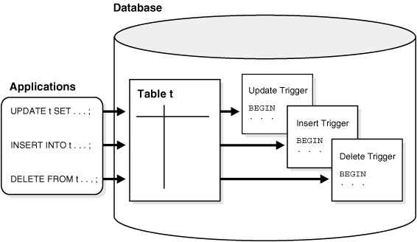
Introduction To Trigger

Slide 5
Uses Of Trigger
Following are use cases where using triggers proves very helpful:
Maintaining complex constraints which is either impossible or very difficult via normal constraint(like primary, foreign, unique etc) applying technique.
Recording the changes made on the table.
Automatically generating primary key values.

Slide 6
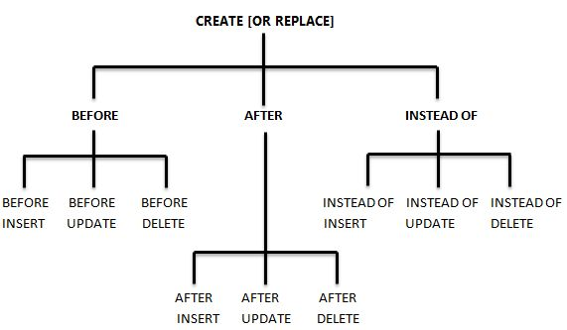
Types Of Triggers

Slide 7
Syntax Of Creating Trigger
CREATE OR REPLACE TRIGGER trigger_name
BEFORE | AFTER
INSERT | UPDATE | DELETE
ON table_name
[FOR EACH ROW]
DECLARE
Declaration-statements
BEGIN
Executable-statements
EXCEPTION
Exception-handling-statements
END;

Slide 8
Syntax Explanation
Following is the explanation of statements that are present in trigger creation.
BEFORE/ AFTER will specify the event timings.
INSERT/UPDATE/DELETE/etc. will specify the event for which the trigger needs to be fired.
ON clause will specify on which object the above-mentioned event is valid. For example, this will be the table name on which the DML event may occur in the case of DML Trigger.
Command "FOR EACH ROW" will specify the ROW level trigger.
The declaration part, execution part, exception handling part is same as that of the other PL/SQL blocks. Declaration part and exception handling part are optional.

Slide 9
Trigger Pseudo Variables
In a row level trigger, the trigger fires for each related row.
And sometimes it is required to know the column values of the effected row before and after the DML statement.
Oracle has provided two clauses in the ROW-level trigger to hold these values. We can use these clauses to refer to the old and new values inside the trigger body.

Slide 10
Trigger Pseudo Variables
:NEW – It holds a new value for the columns of the base table/view during the trigger execution
:OLD – It holds old value of the columns of the base table/view during the trigger execution
On the next slide a table will specify which clause is valid for which DML statement (INSERT/UPDATE/DELETE).

Slide 11
Trigger Pseudo Variables
 | INSERT | UPDATE | DELETE
:NEW | VALID | VALID | INVALID. There is no new value in delete case.
:OLD | INVALID. There is no old value in insert case | VALID | VALID

Slide 12
Rules Regarding :new And :old
If the trigger is an after trigger then we cannot change any field value of :new
We can change the field values of :new for before trigger but it is not allowed for :old

Slide 13
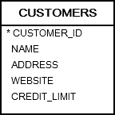
Example
Suppose we have the following table in the database:
Create a trigger that prevents users from updating credit for a customer if the new credit increases to more than double:

Slide 14
Solution
CREATE OR REPLACE TRIGGER customers_update_credit_trg
BEFORE UPDATE
ON customers
FOR EACH ROW
BEGIN
IF :NEW.credit_limit > 2 * :OLD.credit_limit THEN raise_application_error(-20101,'The new credit ' || :NEW.credit_limit || ' cannot increase to more than double, the current credit ' || :OLD.credit_limit);
END IF;
END;

Slide 15
Testing
First, find the credit limit of the customer id 10:
SELECT credit_limit FROM customers WHERE customer_id = 10;
Here is the output:
CREDIT_LIMIT
------------
2000

Slide 16
Testing
UPDATE customers SET credit_limit = 5000 WHERE customer_id = 10;
The output is as follows:
ORA-20101: The new credit 5000 cannot increase more than double, the current credit 2000
ORA-06512: at "OT.CUSTOMERS_UPDATE_CREDIT_TRG", line 4 ORA-04088: error during execution of trigger 'OT.CUSTOMERS_UPDATE_CREDIT_TRG'

Slide 17
Exercise
Create a trigger called checkprice that prevents users from updating or inserting any record in ALLBOOKS table with bookprice other than the range 500 to 700

Slide 18
Exercise
Create a trigger called checkday that prevents users from updating or inserting any record in EMP table with hiredate that falls on weekends

Slide 19
Exercise
Create a trigger called pricediff that displays the price diff whenever the bookprice column is updated in ALLBOOKS table

Slide 20
Performing Audit Trail
Trigger can also be used to perform audit trail on tables.
For example , if a record is deleted from a table then we can use a trigger to save the details of the deleted record to another table

Slide 21
Example
CREATE OR REPLACE TRIGGER books_audit_trg
AFTER DELETE ON allbooks
FOR EACH ROW
BEGIN
INSERT INTO audits (bookid, transaction_name, by_user, transaction_date) VALUES(:old.book_id,’DELETE’, USER, SYSDATE);
END;

Slide 22
Exercise
Modify the previous trigger so that if update is issued then also it records that

Slide 23
Triggering Flags
When a trigger is defined for multiple DML events, Oracle provides us three flags called INSERTING ,UPDATING and DELETING.
One of them becomes true depending on the triggering event.
So , event-specific code can be defined using the INSERTING, UPDATING, DELETING flags.

Slide 24
Solution
CREATE OR REPLACE TRIGGER books_audit_trg
AFTER UPDATE OR DELETE ON allbooks
FOR EACH ROW
DECLARE
trans VARCHAR2(10);
BEGIN
if UPDATING then
trans:=‘UPDATE’;
else
trans:=‘DELTETE’;
end if;
INSERT INTO audits (bookid, transaction_name, by_user, transaction_date) VALUES(:old.book_id,trans, USER, SYSDATE);
END;

